Slide 1
DC Machines

Slide 2
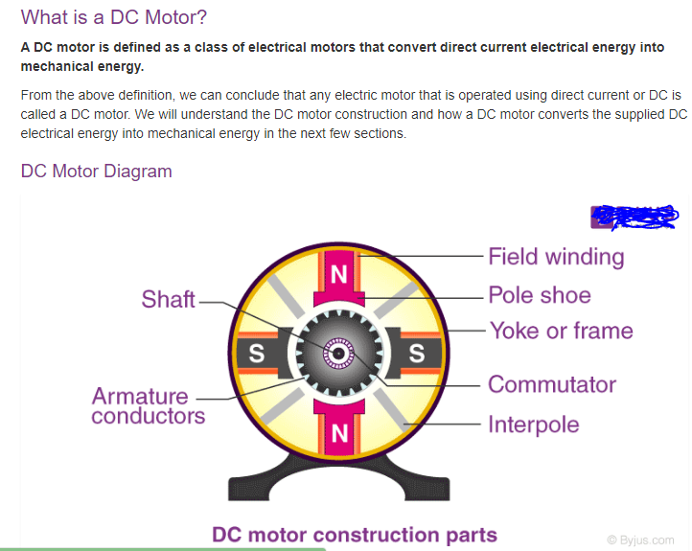

Slide 3
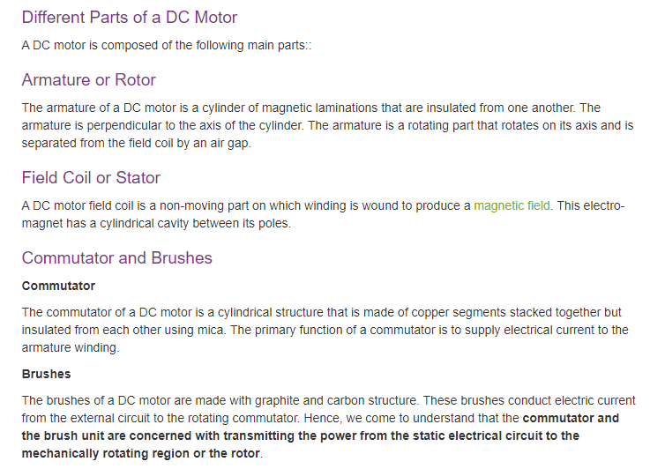

Slide 4
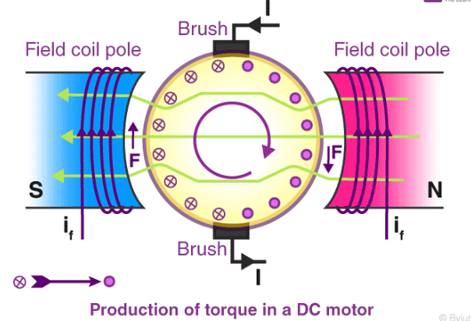

Slide 6
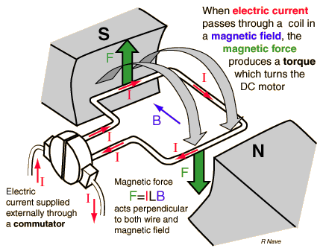
WORKING OF DC MOTOR

Slide 7
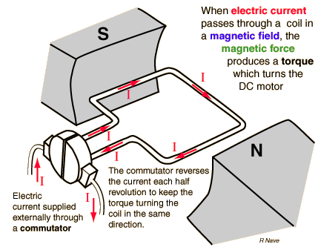
Current in DC Motor

Slide 8
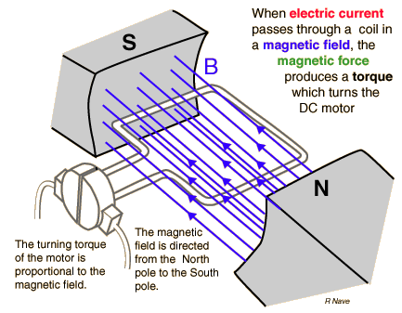
Magnetic Field in DC Motor

Slide 9
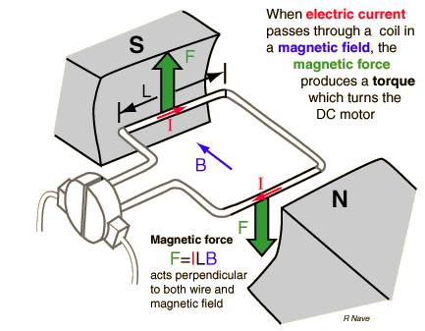
Force in DC Motor

Slide 11
Back EMF in DC Motor
When the current-carrying conductor placed in a magnetic field, the torque induces on the conductor, the torque rotates the conductor which cuts the flux of the magnetic field. According to the Electromagnetic Induction Phenomenon “when the conductor cuts the magnetic field, EMF induces in the conductor”.

Slide 12

The magnitude of the back emf is given by the same expression shown below:
Notes:
Where E_{b} is the induced emf of the motor known as Back EMF, A is the number of parallel paths through the armature between the brushes of opposite polarity. P is the number of poles, N is the speed, Z is the total number of conductors in the armature and ϕ is the useful flux per pole.

Slide 13
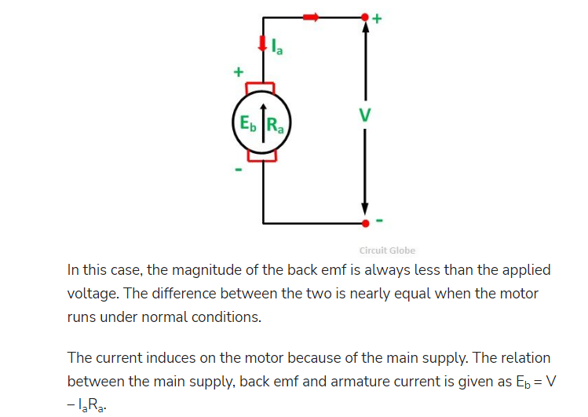

Slide 14
Speed Control of DC motors
According to the speed equation of a dc motor
N ∞ Eb/φ
∞ V- Ia Ra/ φ
Thus speed can be controlled by:
Flux control method: By Changing the flux by controlling the current through the field winding.
Armature control method: By Changing the armature resistance which in turn changes the voltage applied across the armature

Slide 15
Flux Control Method
Advantages:
It provides relatively smooth and easy control
Speed control above rated speed is possible
As the field winding resistance is high the field current is small. Power loss in the external resistance is small . Hence this method is economical
Disadvantages:
Flux can be increased only upto its rated value
High speed affects the commutation, motor operation becomes unstable

Slide 17
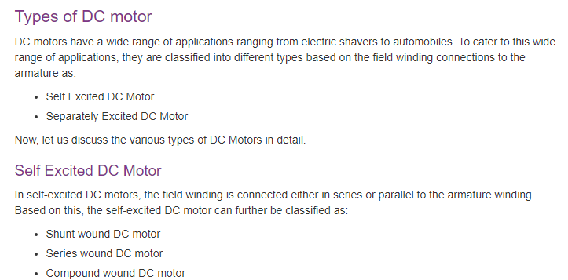
Types

Slide 18
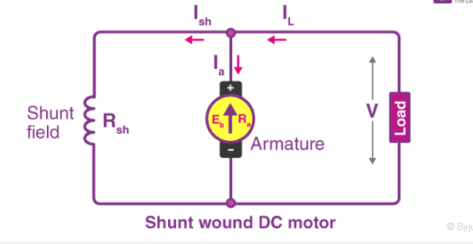

Slide 19
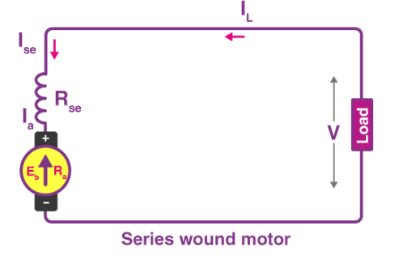

Slide 20
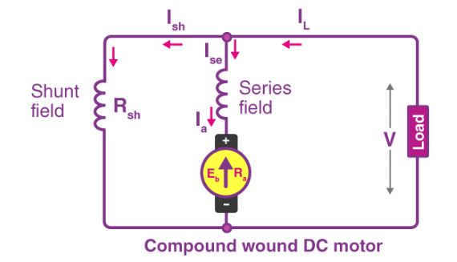

Slide 21
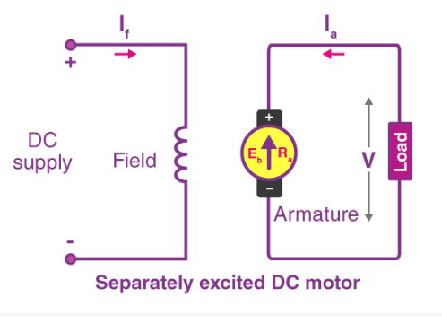

Slide 22
Types of DC Machines
Self-excited DC machine: when a machine supplies its own excitation of the field windings. In this machine, residual magnetism must be present in the ferromagnetic circuit of the machine in order to start the self-excitation process.
Separately-excited DC machine: The field windings may be separately excited from an eternal DC source.
Shunt Machine: armature and field circuits are connected in parallel. Shunt generator can be separately-excited or self-excited.
Series Machine: armature and field circuits are connected in series.

Slide 23
Applications of DC Motors
Shunt Motor:
Blowers and fans
Centrifugal and reciprocating pumps
Lathe machines
Machine tools
Milling machines
Drilling machines

Slide 24
Applications of DC Motors
Series Motor:
Cranes
Hoists , Elevators
Trolleys
Conveyors
Electric locomotives

Slide 25
Applications of DC Motors
Cumulative compound Motor:
Rolling mills
Punches
Shears
Heavy planers
Elevators

Slide 26
DC Generator
Principle-When a conductor moves in a magnetic field it cuts magnetic lines of force, which induces an electromagnetic force (EMF) in the conductor.

Slide 27
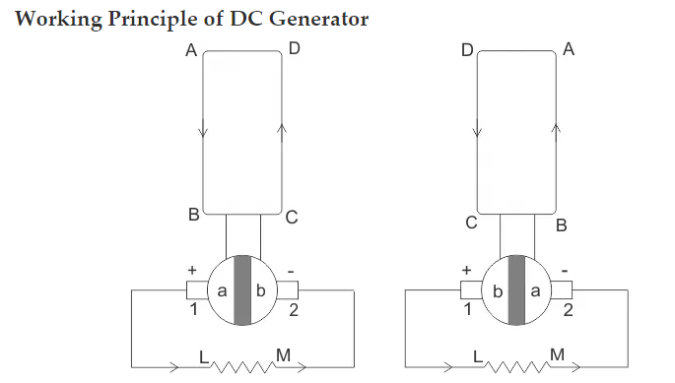

Slide 28
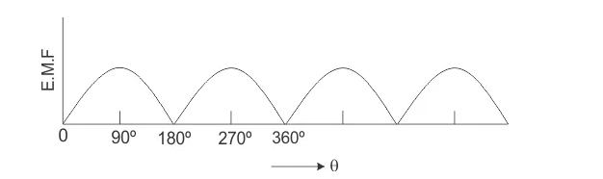
Waveform

